Slide 1
Electronics & Electricity
Unit 2 – Electric Circuits and Devices
Section 1 – Circuits, Voltage, and Current

Slide 2
Electric Circuits and Devices
Circuits, Voltage, and Current

Slide 3
Google classroom code
1c62ger

Slide 4
The big idea
Ability to sketch a basic circuit and identify its four parts
Explain differences between series, parallel, and series-parallel circuits
Define voltage and current
Difference between direct current (DC) and alternating current (AC)
Explain sine waves

Slide 5
Terms
Alternating current
Ampere
Conductor
Current
Cycle
Direct Current
Electric Circuit
Load
Parallel circuit
Series circuit
Voltage

Slide 6
Parts of a circuit
An electric circuit is a combination of parts connected to form a complete path through which electrons move
A basic complete circuit has four parts:
The energy source
The conductors
The load
The control device

Slide 7
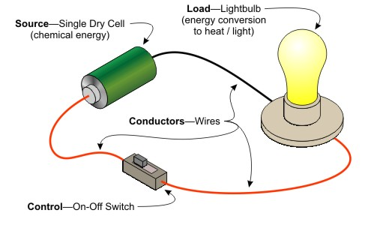

Slide 8
Energy Source
Produces the force that causes electrons to move
Acts like a water pump pushing water through a pipe
The FORCE is called voltage
Electrons are negatively charged so they are attracted by positive charges
Electrons flow from negatively charged object to the positive object
The FLOW of electrons is called current

Slide 9
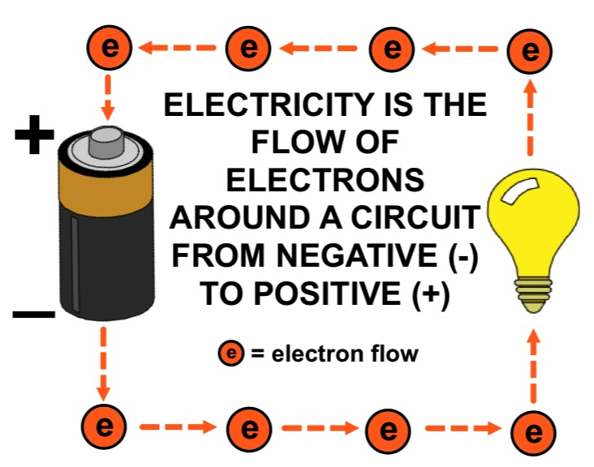

Slide 10
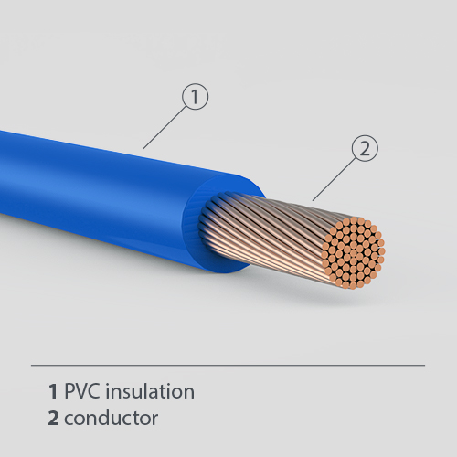
Conductors
Conductors in a circuit provide an easy path through which electrons can move
Copper is the most commonly used conductor material
Copper wire might be bare or covered with some kind of insulating material

Slide 11
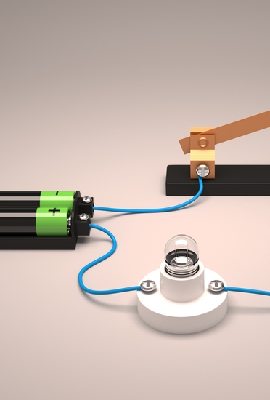
Load
Part of a circuit that changes the energy moving electrons into some other useful form of energy
Common load is that of a light bulb
Loads can be connected in series or parallel

Slide 12
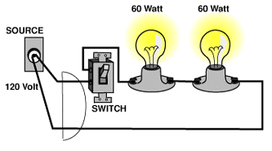
In series
Provides only one path, or one loop

Slide 13
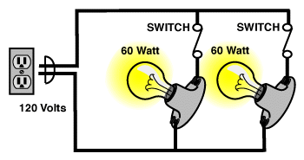
In parallel
There may be two or more different paths, or loops through which electrons flow

Slide 14
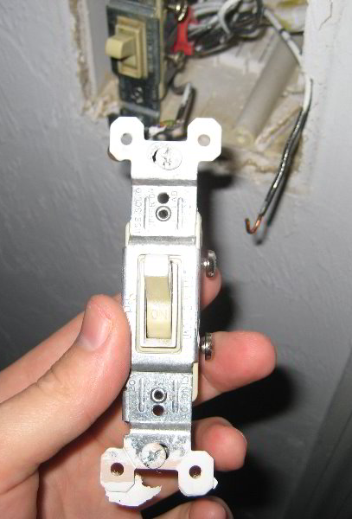
Control Device
Your typical control device is a wall on-off switch
It opens and closes a circuit
Acts as a conductor when on to keep electrons flowing
The circuit is said to be CLOSED
When off, the circuit path is interrupted and electrons can no longer flow
The circuit is said to be OPEN

Slide 15
Voltage
The charge (electron) “pusher.”
Voltage causes current to flow/move.
Voltage sources:
Battery
Generator
Outlets
Symbol for voltage = V
Unit for voltage = Volts (V)

Slide 16
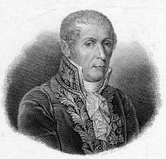
Alessandro Volta (1745 – 1827)
Italian physicist
known especially for the invention of the electrochemical cell, aka the battery in 1800.

Slide 17
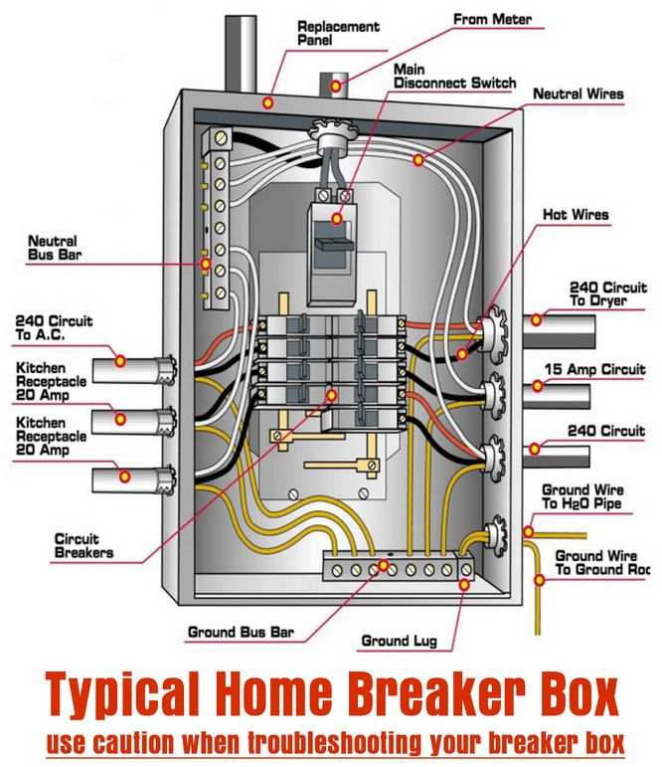
Voltage At Home
Power utilities use large generators to provide the 120V that is delivered to your home outlets.
When you plug in something to the outlet (lamp, blow dryer, TV, etc) the voltage is applied across the circuit, allowing the charge to flow (electric current).

Slide 18
Current
Current: flow of charge (electrons) within a conductor or how fast charge is moving.
Charge will only flow if there is a voltage source (potential difference).
Symbol for Current = I
Unit for Current = Amps (A)

Slide 19
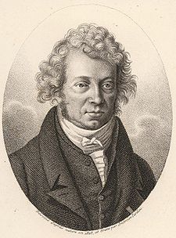
André Ampère (1775 – 1836)
French physicist and mathematician.
One of the main discoverers of electromagnetism.
SI unit of measurement of electric current, the ampere, is named after him.

Slide 20
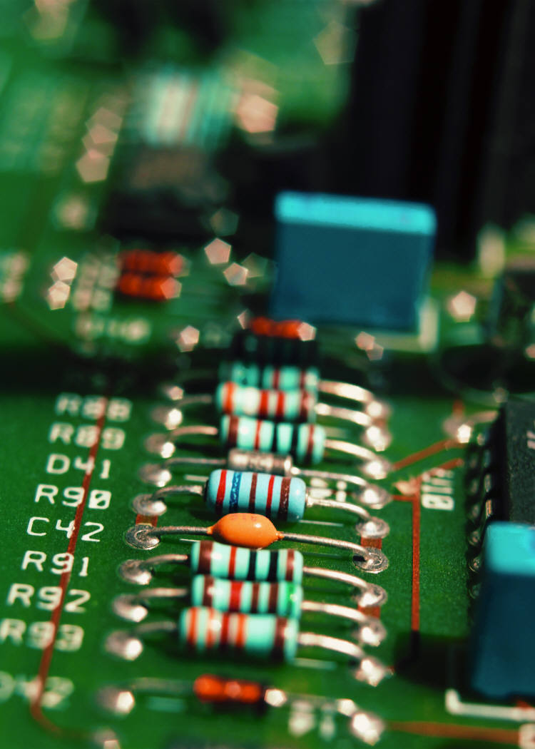
Resistance
Resistance: opposes the push from the voltage source. Resistance affects the speed of the current.
Symbol for Resistance = R
Unit for Resistance = Ohms (Ώ)

Slide 21
Voltage and Current Requirements
For a device to work properly, the source of energy needs to do 2 things:
Supply the voltage
Deliver the current the device is designed for
Ex. You can connect eight flashlight dry cells together to form a battery that produces 12 volts. This most likely would not start a car though as it requires a larger load through current

Slide 22
Direct Current
Produced in a circuit by steady voltage source
Direction of the current does not change over time
Electric cells, batteries, DV generators

Slide 23
Alternating Current
Produced by a voltage source that changes polarity over time
Causes the current to move first in one direction and then in the other direction
Most commonly used AC generator, alternator

